Slide 1

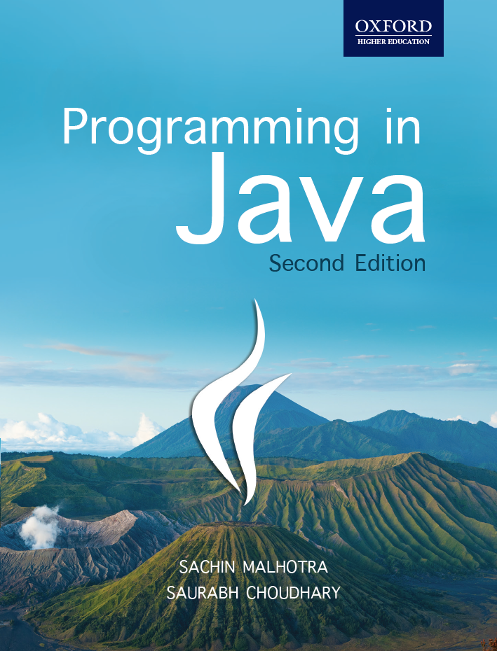
Programming in Java, 2e
Sachin Malhotra
Saurabh Choudhary

Slide 2
Chapter 10
Generics, java.util and Other API

Slide 3
Objective
Understand Collection API and use Generics
Understand the basic data structures in util
Know the basic concept of LinkedList, ArrayList, and Vector
understand Set, HashSet, and TreeSet
understand Map, HashMap, and TreeMap
use Collections class
use Enumeration and Iterator
understand the usage of random class
implement observer pattern
understand runtime class
learn about reflection API

Slide 4
Introduction
Utility means usefulness. Utility classes are those that help in creation of other classes.
The java.util package contains utility classes like
  Date,
  Calendar,
  Stack,
  LinkedList,
  StringTokenizer, etc.

Slide 5
Introduction (contd.)
The classes in java.util package use collections, i.e. a group of objects.
  Collection Classes work on objects, i.e. they store/retrieve objects.
  Primitives cannot be directly stored and retrieved in collections.
  Wrapper classes representing primitives were created in java.lang package to work with collections.

Slide 6
Introduction (contd.)
The java.util package has an interface named Collection. A collection supports a group of objects.
A collection may be
  ordered/unordered as well as some collections
  may possess duplicates while others may not.
This collection interface has sub-interfaces like Set, List, Queue, etc.
  These interfaces have concrete subclasses like LinkedList, Stack, Vector, etc.
Besides Collection, we have shown another interface Map which work on pairs – Key/value pairs.
  This interface has a nested interface named Entry.

Slide 7
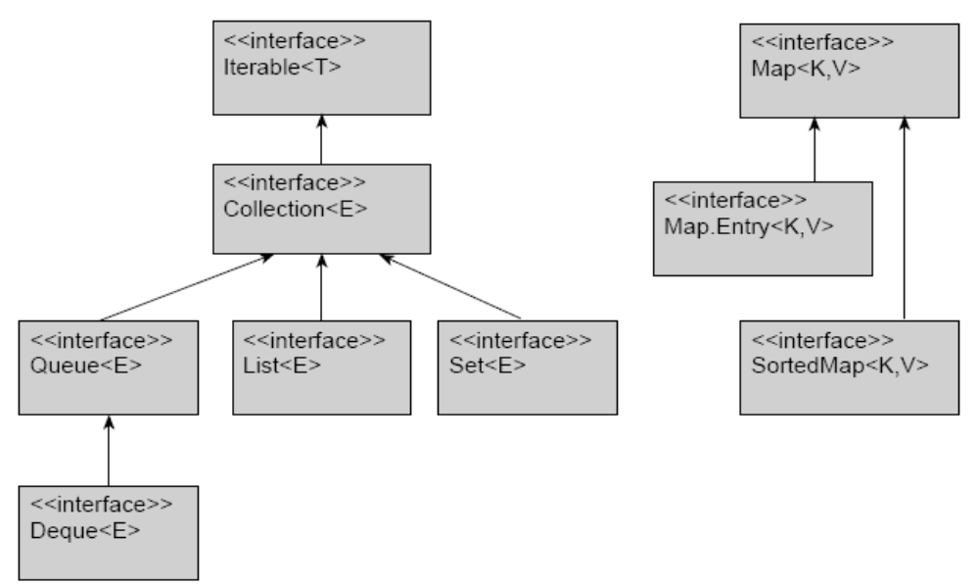
Collection Inheritance hierarchy

Slide 8
Collection Inheritance hierarchy
The java.lang.Iterable interface was added by JDK 1.5 and Collection interface was made to inherit it so that the objects can be iterated using a for-each loop.
  This interface provides a method named iterator() that returns an Iterator object to iterate all the objects in the collection.
The Collection interface is implemented by an abstract class AbstractCollection, which is the parent of all the collection classes
List interface refers to an ordered but duplicate collection of objects.

Slide 9
Collection inheritance hierarchy
We refer to a List as ordered because the user has full control over the order in which an object is inserted into the list.
  The top level class for List interface is an abstract class AbstractList (which is a subclass of AbstractCollection).
  AbstractList implements almost all the methods of List interface and has three subclasses AbstractSequentialList, ArrayList, and Vector.
  LinkedList class is subclass of AbstractSequentialList and its definition has been modified in JDK 1.6 to implement the Deque interface.
Stack is a subclass of the Vector class.

Slide 10
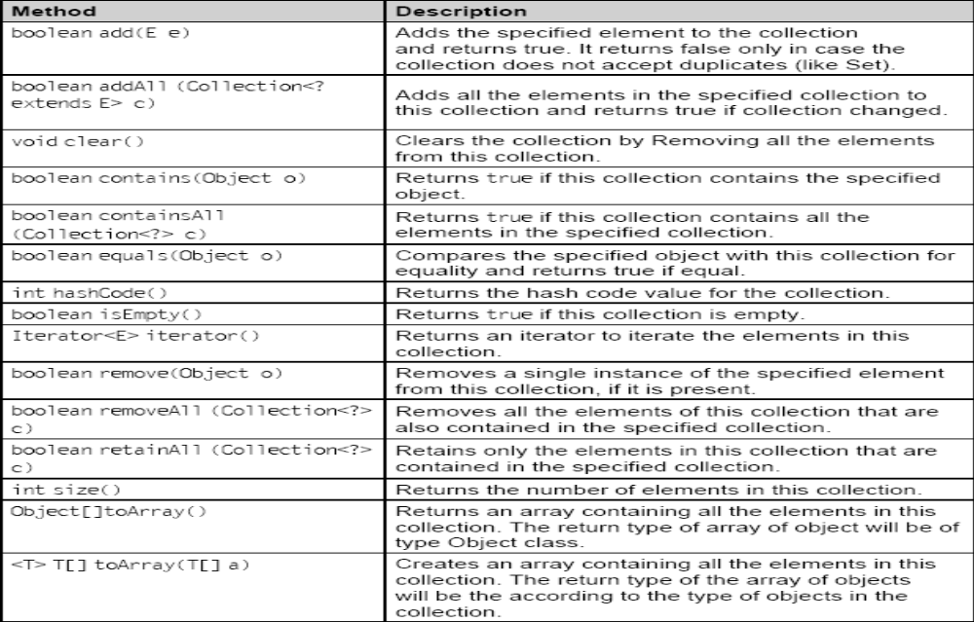
Methods of Collection Interface

Slide 11
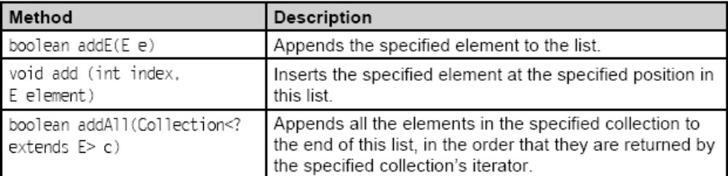
Methods of List interface

Slide 12
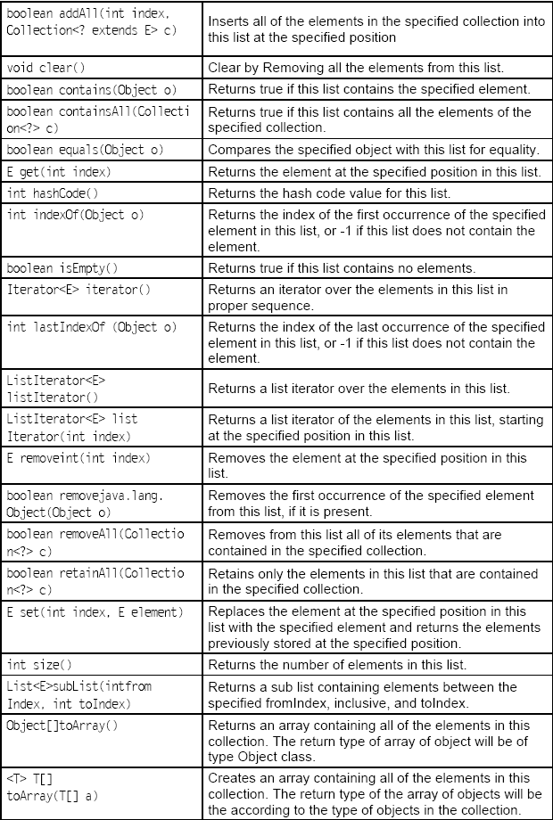
Methods of List interface

Slide 13
Queue interface
Queue interface was added in JDK 1.5 to support the data structure.
  Queue operates in FIFO (first in first out fashion).
  Elements inserted into collection first are removed from the collection first.
  These queues support operations to add/remove/examine elements at both ends (head and tail) of the queue.

Slide 14
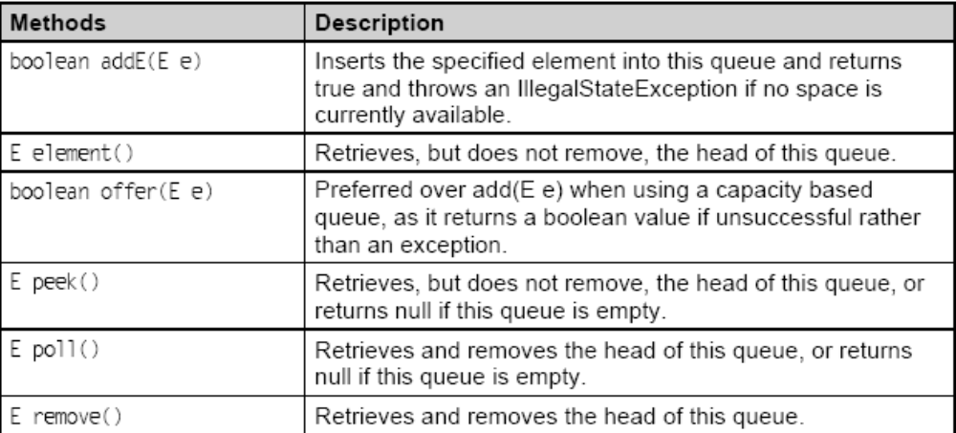
Methods of Queue interface

Slide 15
Set Interface
Set is a collection that does not contain duplicate objects.
This interface is implemented by an abstract class AbstractSet which implements some of the methods of Set interface.
  The concrete classes, HashSet, EnumSet, etc., are subclasses of AbstractSet.
  This interface is inherited by SortedSet interface to access the element in a sorted order (ascending).
  The class TreeSet inherits the SortedSet interface and the AbstractSet class.

Slide 16
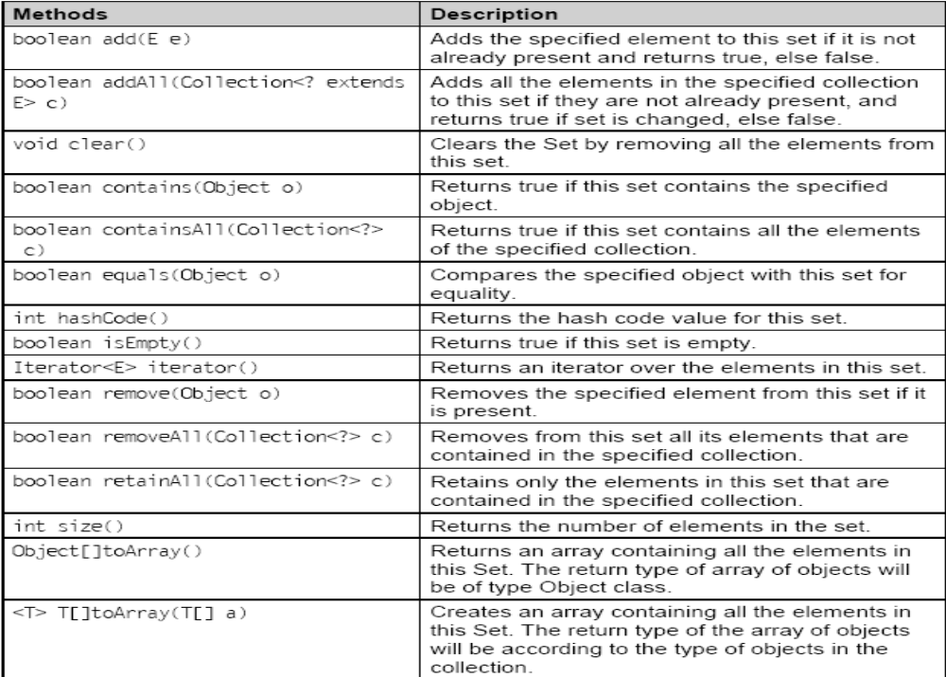
Methods of Set interface

Slide 17
Map interface
Map interface provides mapping of key/value pairs.
  This key/value pairs are unique.
  A static inner interface named Entry is declared inside the Map interface for referring to each key/value pair.
  This Map is inherited by an interface SortedMap to access the elements stored in Map in a sorted order.
  AbstractMap class inherits the Map interface.
  This class is inherited by concrete classes like HashMap; EnumMap, etc.
  TreeMap also inherits this class as well as the interface SortedMap.
Most of the interfaces and classes in the java.util package use Generics.

Slide 18
Generics
were added in Java 5 to provide strict type checking at compile time.
allows same class to be used by many different collection of objects like String, Integer, etc.
Consider the following example where we have created three classes named A, B and GenericTest.
  The class GenericTest has a collection of ArrayList class to hold objects.
  We have placed the objects of A and B in it and later we try to retrieve them.

Slide 19
Example
import java.util.*;
class A {
public String toString(){return “Class A Object”; }}
class B
{ public String toString(){return “Class B object”;}}
class GenericTest {
public static void main(String args[]) {
List v=new ArrayList();
v.add(new A());
v.add(new A());
v.add(new B());
Iterator en=v.iterator();
while(en.hasNext()) {
A o=(A)en.next();
System.out.println(o); }}}

Slide 20
What happens while compiling the program?
C:\javabook\programs\chap 10>javac GenericTest.java
Note: GenericTest.java uses unchecked or unsafe operations.
Note: Recompile with -Xlint:unchecked for details.
C:\javabook\programs\chap 10>javac -Xlint:unchecked GenericTest.java
GenericTest.java:15: warning: [unchecked] unchecked call to add(E) as a member of the raw type java.util.List v.add(new A()); ^
GenericTest.java:16: warning: [unchecked] unchecked call to add(E) as a member of the raw type java.util.List v.add(new A()); ^
GenericTest.java:17: warning: [unchecked] unchecked call to add(E) as a member of the raw type java.util.List v.add(new B()); ^
3 warnings

Slide 21
The Output
C:\javabook\programs\chap 10>java GenericTest
Class A Object
Class A Object
Exception in thread “main” java.lang.ClassCastException: B cannot be cast to A at GenericTest.main(GenericTest.java:21)

Slide 22
Problem & Solution
The problem occurred because there was no restriction on the type of objects that can be put into a collection.
  In the earlier example we had put objects of A as well as B into the collection and we are casting all objects into A which raised an alarm at run time.
It would be much better to check at compile time what goes into a collection so that no exception occurs at run time.
  If we could ensure only objects of A should go into the collection then the problem can be solved and that’s where Generics help.

Slide 23
Problem & Solution
Most of the interfaces/ classes as well as some of the methods have been modified to use Generic syntax. The generic declaration of List is
  List<E> v=new ArrayList<E>();
  This E has been replaced by A as shown. Single Capital character are used to denote generic Formal parameterized types
  List<A> v=new ArrayList<A>(); //List of objects of A (actual parameter)
  The name placed in the angle brackets (commonly known as specifying parameterized type) is class name whose objects we want to put into a collection.

Slide 24
Problem & Solution
  Now this collection will not contain objects of class other than the class-name mentioned in the angle brackets.
  For e.g. If we try to insert an object of type B into collection ‘v’(after using parameterized types), a compile time error results.
The point worth mentioning here is that the List now contains only objects of type ‘A’ and the compiler assures us of this.
So is the cast on Line 14 really required?
  Well logically it should not be required but if you remove the cast on Line 14, the compiler complains about it.
  Why?

Slide 25
Problem & solution
  The reason is we did parameterize the List but we did not parameterize the Iterator which continued to return an object of type Object on invocation of next method.
Similar to List, Iterator also uses the Generic parameterized types. So if we change the Line 12 as shown the problem gets solved and the cast can now be removed safely.
  Iterator<A> en=v.iterator();
  while(en.hasNext()){
  A o=en.next();
  System.out.println(o);}

Slide 26
Modified Example
class GenericTest {
public static void main(String args[])
{
// Collection that will hold only object of A
List<A> v=new ArrayList<A>();
v.add(new A());
v.add(new A());
// to show that the Iterator will also hold objects of A
Iterator<A> en=v.iterator();
while(en.hasNext())
{
A o=en.next();// the cast in this line is gone
System.out.println(o);
}}}

Slide 27
Using generics and arguments in return types
Generics are applicable
  for passing parameters to a method
  as well as returning parameters from a method.
Let us take a look at how parameterized type is used in passing arguments and how to return parameterized types.
The following example creates a List that holds only String objects.

Slide 28
Example
import java.util.*;
class ParamArgsGeneric{
// method returning parameterized types
List<String> getList() {
List<String> l=new ArrayList<String>();
l.add(“Hello”);
l.add(“Generics”);
return l;
}
// method accepting parameterized types
void print(List<String> c)
{
Iterator<String> i=c.iterator();

Slide 29
Example (contd.)
while(i.hasNext())
System.out.println(i.next());
}
public static void main(String args[])
{
ParamArgsGeneric pag=new ParamArgsGeneric();
/*Line 13*/List<String> l=pag.getList();
pag.print(l);
}}

Slide 30
The Output
C:\javabook\programs\chap 10>java ParamArgsGeneric
Hello
Generics

Slide 31
Wildcards
In the Example 10.2, if we change Line 13 as follows
  List<Object> l = pag.getList();
Anybody would consider it legal arguing
  Object is the super class of String so the assignment should be legal, but that’s not the case. A List of Object is not a List of String. Why?
Consider the case if a List of String is a List of Object that means the above modified Line 13 is supposedly working.
Then we could also insert lines in the program to add objects of type Object to the List. Now when we retrieve them and try to store in a List of String it gives me a Cast exception because we are trying to store an Object into a String.
So a List of Object is not a List of String and vice-versa.

Slide 32
Wildcards (contd.)
If you want to be flexible in using the classes as they were used earlier i.e. without parameterized types then
  either you will have to suppress the warnings or
  you will have to be rigid in the using Collection of a particular type.
we can use the Collection to hold different types of object not just a particular type using Generic syntax. This is possible with the help of Wildcards i.e. ‘?’.
Let us take a look at how wildcards can be used.

Slide 33
Example
import java.util.*;
class ParamArgsGeneric {
List<?> getList() {
List<String> l=new ArrayList<String>();
l.add(“Hello”);
l.add(“Generics”);
return l; }
// accepts any Collection
void print(Collection<?> c){
Iterator<?> i=c.iterator();
while(i.hasNext())
System.out.println(i.next());
}

Slide 34
Example (contd.)
public static void main(String args[])
{
ParamArgsGeneric pag=new ParamArgsGeneric();
List<?> l=pag.getList();
pag.print(l);
// another List created and passed to print()
List<Integer> li=new ArrayList<Integer>();
li.add(new Integer(1));
li.add(new Integer(2));
li.add(new Integer(3));
pag.print(li);
}}

Slide 35
The Output
C:\javabook\programs\chap 10>java ParamArgsGeneric
Hello
Generics
1
2
3

Slide 36
Can we re-write
  List<String> l=new ArrayList<String>();
  as:
  List<?> l=new ArrayList<String>();
It is illegal.
For a very simple reason, that a List of unknowns need not necessarily be a List of String.
So wildcards can be used in passing parameterized types as arguments / return types as well as capturing the return values from the methods.

Slide 37
Bounded Wildcard
Bounded wildcards place certain restriction on the type of objects that a collection can hold. For e.g. ? extends X
? Specifies unknown type, but this unknown type will be a subclass of X.
So in this case we know that this unknown type is either X or one of its subclasses.
In the following example we have created three classes A, B and C.
  class B inherits from A.
  C is an independent class.
  Now let us see how bounded wildcards place a restriction on collection of objects.

Slide 38
Example
import java.util.*;
class A
{ public String toString(){return “class A”;}}
class B extends A
{ public String toString(){return “class B”;}}
class C {}
class BoundedWildcard{
void print(List<? extends A> c){
Iterator<?> i=c.iterator();
while(i.hasNext())
System.out.println(i.next()); }

Slide 39
Example
public static void main(String args[]){
BoundedWildcard pag=new BoundedWildcard();
List<B> li=new ArrayList<B>();
li.add(new B());
li.add(new B());
pag.print(li);
List<A> la=new ArrayList<A>();
la.add(new A());
la.add(new A());
pag.print(la);
List<C> lc=new ArrayList<C>();
lc.add(new C());
lc.add(new C());
//pag.print(lc); }}

Slide 40
The Output
C:\javabook\programs\chap 10>java BoundedWildcard
class B
class B
class A
class A

Slide 41
Define your own Generic class
You can create your own classes that use generic syntax.
For using a Generic syntax in your classes, a normal naming convention should be followed for specifying parameterized types.
The naming convention is a single Capital Letter used for specifying parameterized types.
  For e.g. T is for specifying any type.
  The letter E has been used in the java Collection API extensively to denote Collection elements.
  In Map the alphabet K for keys and V for values.

Slide 42
Example
class A<T> {
private T var;
public A(){
var=null;}
public A(T a){
var=a;}
public T getVar(){
return var;}
public void setVar(T a){
var=a;}}

Slide 43
Example (contd.)
class TestGeneric{
public static void main(String args[]){
System.out.println(“The User Defined Generic class holds Integer Object”);
A<Integer> v=new A<Integer>(new Integer(1));
System.out.println(“Value: “+v.getVar());
v.setVar(new Integer(3));
System.out.println(“New Value: “+v.getVar());
System.out.println(“The User Defined Generic class holds String Object”);
A<String> a=new A<String>(“User Defined Generics”);
System.out.println(“Value: “+a.getVar());}}

Slide 44
The Output
C:\javabook\programs\chap 10>java TestGeneric
The User Defined Generic class holds Integer Object
Value: 1
New Value: 3
The User Defined Generic class holds String Object
Value: User Defined Generics

Slide 45
Your turn
Let us take a quick recap of the concepts:
Queue
Stack
What are Generics?
What is the use of Wildcards in generics?
What are bounded wildcards?

Slide 46
Linked List
Linked list is a fundamental data structure that contains records.
  A record contains data as well as a reference to the next record.
  A record can be inserted or removed at any point in the Linked List.
  In comparison to normal arrays which allow random access, Linked lists allow sequential access.
  To support this data structure, java has a class named LinkedList.
LinkedList is a collection class that can act as a stack, queue as well as a double-ended queue.
  LinkedList permits null to be added to the list.

Slide 47
Example
The following example shows how LinkedList can act as a list, stack, queue as well as a double-ended queue
import java.util.*;
class LinkedListDemo{
public static void main(String args[]) {
LinkedList<String> lis=new LinkedList<String>();
lis.add(“Hello”);
lis.add(“Linked List”);
lis.add(“Demo”);
lis.add(null);
for(String s:lis)
System.out.println(s);

Slide 48
Example (contd.)
// as a Stack (LIFO order)
LinkedList<Integer> st=new LinkedList<Integer>();
st.push(new Integer(1));
st.push(new Integer(2));
st.push(new Integer(3));
st.add(new Integer(4));
System.out.println(“Object popped: “+st.pop());
System.out.println(“Object popped: “+st.pop());
System.out.println(“Object popped: “+st.pop());
System.out.println(“Object popped: “+st.pop());
LinkedList<Long> l=new LinkedList<Long>();

Slide 49
Example (contd.)
// as queue (FIFO order)
l.add(new Long(1));
l.add(new Long(2));
l.add(new Long(3));
l.add(new Long(4));
System.out.println(“Queue : “+l);
System.out.println(“head of queue: “+l.peek());
System.out.println(“head of queue removed and returned: “+l.poll());
System.out.println(“Queue : “+l);

Slide 50
Example (contd.)
//as a double ended queue insertion and deleltion at both // ends
l.addFirst(new Long(0));
System.out.println(“Double ended Queue : “+l);
l.addLast(new Long(5));
System.out.println(“Double ended Queue : “+l);
System.out.println(“head of queue removed and returned: “+l.removeFirst());
System.out.println(“tail of Queue removed and returned: “+l.removeLast());
System.out.println(“Double ended Queue : “+l); }}

Slide 51
The Output
C:\javabook\programs\chap 10>java LinkedListDemo
Hello
Linked List
Demo
null
Object popped: 3
Object popped: 2
Object popped: 1
Object popped: 4
Queue : [1, 2, 3, 4]
head of queue: 1
head of queue removed and returned: 1
Queue : [2, 3, 4]

Slide 52
The Output
Double ended Queue : [0, 2, 3, 4]
Double ended Queue : [0, 2, 3, 4, 5]
head of queue removed and returned: 0
tail of Queue removed and returned: 5
Double ended Queue : [2, 3, 4]

Slide 53
Set
Set is a collection that does not contain duplicates.
  Set collection in java.util models the mathematical concept set.
  The concepts of Union, Intersection and difference of a set are available in the Set interface and supported by its subclasses.
Two subclasses exists
  HashSet and TreeSet.
  TreeSet is a sorted collection as it inherits the SortedSet interface (sub-interface of Set) whereas
  HashSet is not a sorted collection.
HashSet uses the concept of Hashing.

Slide 54
HashSet
This class can be used for effectively storing and retrieving the elements but the order is not guaranteed by this class.
In case you need to retrieve the elements in a sorted order use TreeSet class.
HashSet permits null to be added to the collection.
Let us take an example to demonstrate HashSet class.

Slide 55
Example
import java.util.*;
class HashSetDemo{
public static void main(String args[]){
HashSet<String> hs=new HashSet<String>();
hs.add(“D”);
hs.add(“B”);
hs.add(“A”);
hs.add(“C”);
hs.add(null);
hs.add(“E”);
System.out.println(“Hash Set: ”+hs);
System.out.println(“Re-adding C to set: ”+hs.add(“C”));

Slide 56
Example (contd.)
System.out.println(“Iterating contents of Hash Set one by one”);
for(String s:hs)
System.out.println(“\t”+s);
System.out.println(“Size of Hash Set: ”+hs.size());
System.out.println(“null removed: ”+hs.remove(null));
System.out.println(“Hash Set: ”+hs);
System.out.println(“check whether Set contains C :”+hs.contains(“C”));
HashSet<String> hs1=new HashSet<String>();
hs1.add(“D”);
hs1.add(“B”);
hs1.add(“E”);

Slide 57
Example (contd.)
/*subset*/ System.out.println(“hs: ”+hs);
System.out.println(“hs1: ”+hs1);
System.out.println(“hs1 is a subset of hs: ”+hs.containsAll(hs1));
/*Intersection*/
hs.retainAll(hs1);
System.out.println(“Intersection of hs and hs1: ”+hs);
/*Difference*/ hs.removeAll(hs1);
System.out.println(“Difference of hs and hs1: ”+hs);
/*Union*/
System.out.println(“Hash Set to be united with previous set: ”+hs1);
hs.addAll(hs1);
System.out.println(“Union of hs and hs1: ”+hs);}}

Slide 58
The Output
C:\javabook\programs\chap 10>java HashSetDemo
Hash Set: [null, D, E, A, B, C]
Re-adding C to set: false
Iterating contents of Hash Set one by one
null
D
E
A
B
C
Size of Hash Set: 6
null removed: true

Slide 59
The output (contd.)
Hash Set: [D, E, A, B, C]
check whether Set contains C :true
hs: [D, E, A, B, C]
hs1: [D, E, B]
hs1 is a subset of hs: true
Intersection of hs and hs1: [D, E, B]
Difference of hs and hs1: []
Hash Set to be united with previous set: [D, E, B]
Union of hs and hs1: [D, E, B]

Slide 60
TreeSet
offers a strict control over the order of elements in the collection.
The collection is a sorted collection.
may not offer you the best performance in terms of retrieving elements speedily (use HashSet instead of TreeSet).
does not permit null in the collection.

Slide 61
TreeSet Example
import java.util.*;
class TreeSetDemo{
public static void main(String args[]){
TreeSet<String> ts=new TreeSet<String>();
ts.add(“D”); ts.add(“B”); ts.add(“A”);
ts.add(“C”); ts.add(“A”); ts.add(“C”);
//ts.add(null); does not accepts null values
for(String s:ts)
System.out.println(s);
System.out.println(“TreeSet: “+ts);
System.out.println(“First element of TreeSet: “+ts.first());
System.out.println(“Last element of TreeSet: “+ts.last());
System.out.println(“Size of TreeSet: “+ts.size());}}

Slide 62
The Output
C:\javabook\programs\chap 10>java TreeSetDemo
A
B
C
D
TreeSet: [A, B, C, D]
First element of TreeSet: A
Last element of TreeSet: D
Size of TreeSet: 4

Slide 63
Maps
Map allows unique Key/value pairs to be added.
A Map collection stores key along with their associated values.
These keys in Map are unique.
Map does not allow null key and values.
Two subclasses of Map interface
  HashMap and
  TreeMap

Slide 64
HashMap
HashMap, alike HashSet uses hashing as a technique to store Key/value pairs so that the values can be searched efficiently according to the key.
There order is not guaranteed by HashMap.
The HashMap does not allow null key and null value pair to be stored.

Slide 65
HashMap Example
import java.util.*;
class HashMapDemo{
public static void main(String args[]){
HashMap<String,String> hm=new HashMap<String,String>();
hm.put(“Emp001”,”Tom”);
hm.put(“Emp002”,”Peter”);
hm.put(“Emp003”,”Watson”);
//hm.add(null,null);
System.out.println(“HashMap: “+hm);
System.out.println(hm.put(“Emp003”,”David”));
System.out.println(“HashMap: “+hm);
System.out.println(“Key in Map”);

Slide 66
HashMap Example (contd.)
for(String s:hm.keySet())
System.out.println(s);
System.out.println(“Values in Map”);
for(String s:hm.values())
System.out.println(s);
System.out.println(“value associated with Emp002: “+hm.get(“Emp002”));
System.out.println(“Size of HashMap: “+hm.size());
System.out.println(“remove mapping associated with Emp002: “+hm.remove(“Emp002”));
System.out.println(“HashMap after removal: “+hm); }}

Slide 67
The Output
C:\javabook\programs\chap 10>java HashMapDemo
HashMap: {Emp002=Peter, Emp003=Watson, Emp001=Tom}
Watson
HashMap: {Emp002=Peter, Emp003=David, Emp001=Tom}
Key in Map
Emp002
Emp003
Emp001
Values in Map
Peter
David
Tom
value associated with Emp002: Peter
Size of HashMap: 3
remove mapping associated with Emp002: Peter
HashMap after removal: {Emp003=David, Emp001=Tom}

Slide 68
Tree Map
TreeMap contain sorted mapping of key/value pairs.
import java.util.*;
class TreeMapDemo{
public static void main(String args[]){
TreeMap<String,String> tm=new TreeMap<String,String>();
tm.put(“Emp001”,”Tom”);
tm.put(“Emp002”,”Peter”);
tm.put(“Emp003”,”Watson”);
// tm.add(null,null);
System.out.println(“TreeMap: “+tm);
tm.put(“Emp003”,”David”);

Slide 69
TreeMap Example
System.out.println(“TreeMap: “+tm);
System.out.println(“Key in Map”);
for(String s:tm.keySet())
System.out.println(s);
System.out.println(“Values in Map”);
for(String s:tm.values())
System.out.println(s);
System.out.println(“value associated with Emp002: “+tm.get(“Emp002”));
System.out.println(“Size of TreeMap: “+tm.size()); }}

Slide 70
The Output
C:\javabook\programs\chap 10>java TreeMapDemo
TreeMap: {Emp001=Tom, Emp002=Peter, Emp003=Watson}
TreeMap: {Emp001=Tom, Emp002=Peter, Emp003=David}
Key in Map
Emp001
Emp002
Emp003
Values in Map
Tom
Peter
David
value associated with Emp002: Peter
Size of TreeMap: 3

Slide 71
Your turn
Let us take a recap of the concepts:
What are Linked List?
What are the essential qualities of Set?
  HashSet
  TreeSet
What are the essential qualities of Map?
  HashMap
  TreeMap

Slide 72
Collections class
Collections class contains a number of static methods that operate on Collection
  like copy a Collection,
  reversing the elements of a Collection,
  replacing an element with another and soon.
Let us take an example.

Slide 73
Collections class Example
import java.util.*;
public class CollectionsDemo {
public static void main(String[] args) {
List<String> l = new LinkedList<String>();
l.add(“Ignorance”); l.add(“is”); l.add(“a”);
List<String> sb = new LinkedList<String>();
sb.add(“Bliss”);
List<String> srch =new LinkedList<String>();
srch.add(“Bliss”);
System.out.println(“Elements in list : “ + l);
// create a copy of defined list and print objects of copy list.
Collections.copy(l,sb);
System.out.println(“copy of list : “ + l);
// find and display index of first occurrence of sublist in the list.
System.out.println(“First index of ‘Bliss’: “ + Collections.indexOfSubList(l, srch));

Slide 74
Collections class Example (contd.)
// replace all objects in list by a new given object.
Collections.replaceAll(l, “Bliss”, “welcome”);
System.out.println(“After replace all ‘Bliss’: “ + l);
// list in reverse order.
Collections.reverse(l);
System.out.println(“List in reverse order: “ + l);
// swaps specified element with element at 1st(second) position
Collections.swap(l, 1, l.size() - 1);
System.out.println(“List after swapping : “ + l);
// Replace all the element with given element using fill()
Collections.fill(l, “Bliss”);
System.out.println(“After filling all ‘Bliss’ in list : “+ l);
// getting an enum type of specified list through enumeration().
Enumeration<String> e = Collections.enumeration(l);
while (e.hasMoreElements())
System.out.println(e.nextElement()); }}

Slide 75
The Output
C:\javabook\programs\chap 10>java CollectionsDemo
Elements in list : [Ignorance, is, a]
copy of list : [Bliss, is, a]
First index of ‘Bliss’: 0
After replace all ‘Bliss’: [welcome, is, a]
List in reverse order: [a, is, welcome]
List after swapping : [a, welcome, is]
After filling all ‘Bliss’ in list : [Bliss, Bliss, Bliss]
Bliss
Bliss
Bliss

Slide 76
Legacy classes
Vector and ArrayList classes are both used to support the functionality of dynamic arrays.
Array cannot grow/shrink in size so these classes have been provided in java.util package to support Collection that can grow/shrink in size.
Vector is synchronized whereas ArrayList is not.
  That means a Vector collection is thread-safe when accessed by multiple threads.
  On the other hand an ArrayList offers better performance as it is not synchronized.

Slide 77
Legacy classes
Vector<String> v = new Vector<String>();
The elements can be added to the Vector using add(E e) method as shown
v.add(“One”);
v.add(“Two”);

Slide 78
Legacy Interfaces
Enumeration is a Legacy interface.
work with classes like Vector.
Suppose the Vector contains Integer objects.
  To iterate through the Collection we obtain an Enumeration by calling the elements() method of the Vector object.
  This Enumeration has two methods
    hasMoreElements() that returns a boolean value to indicate that the collection has more values and the
    nextElement() returns the next Element in the collection.
  Enumeration<Integer> en=v.elements();
  While(e.hasMoreElements())
  System.out.println(e.nextElement());

Slide 79
Random class
Used to generate random numbers
  Random r = new Random();
  Random r = new Random(seed);
  A seed is a number used to initialize a pseudorandom number generator
int randomInt = r.nextInt(n);
  generate random integers between 0 and some limit (n-1).

Slide 80
Random class Example
Random randomGenerator = new Random();
for (int i = 1; i <= 6; ++i) {
int randomInt = randomGenerator.nextInt(6)+1;
System.out.println(i+ ". Integer Random Number: "+randomInt); }
double randomDouble = randomGenerator.nextDouble();
System.out.println("Double Random Number: "+ randomDouble);
float randomFloat = randomGenerator.nextFloat();
System.out.println("Float Random Number: "+randomFloat);

Slide 81
Observer and Observable
A particular object (i.e., Observer) should be notified when the state of another object (i.e., Observable object) changes
For example, you (Observer) are notified about the transaction updates of your bank account (Observable),
as soon as the data (Observable) related to the pie chart or bar chart is updated the graphs (Observer) automatically adjust to the changes and so on.

Slide 82
Observable and Observer
import java.util.Observable; import java.util.Observer;
class Bank {
Account a,a1;
Customer c,c1;
public Bank() {
c = new Customer("Rahul","C001",a=new Account(12000,"A001"));
c1 = new Customer("Ram","C002",a1=new Account(12000,"A002"));
a.addObserver(c);
a1.addObserver(c1);
}

Slide 83
Example (contd.)
public static void main(String[] args){
Bank b = new Bank();
b.demo();}
public void demo(){
a.credit(1000);
a.debit(500);
a1.debit(2000);
a1.credit(6000); }}

Slide 84
Example (contd.)
class Customer implements Observer{
String custName; String custId;
Account account;
Customer(String custName,String custId, Account account){
this.custName = custName;
this.custId = custId;
this.account = account;}
public void update(Observable obs, Object x) {
System.out.println(custName+ " Account Update" + ": " + ((Account)obs).getBalance()); } }

Slide 85
Example (contd.)
class Account extends Observable{
float balance;
String accountNo;
Account(float b, String acc){
balance = b;
accountNo = acc;}
Account() {
balance = 0;
accountNo = "";}

Slide 86
Example (contd.)
float getBalance()
{return balance;}
void setBalance(float b){
balance = b;}
String getAccountNo(){
return accountNo;}
void setAccountNo(String acc){
accountNo = acc;}

Slide 87
Example (contd.)
public void credit(float amount){
balance = balance+amount;
setChanged();
notifyObservers();}
public void debit(float amount){
balance=balance-amount;
setChanged();
// Notify observers of change
//notifyObservers(this);
notifyObservers();}}// Account class ends here

Slide 88

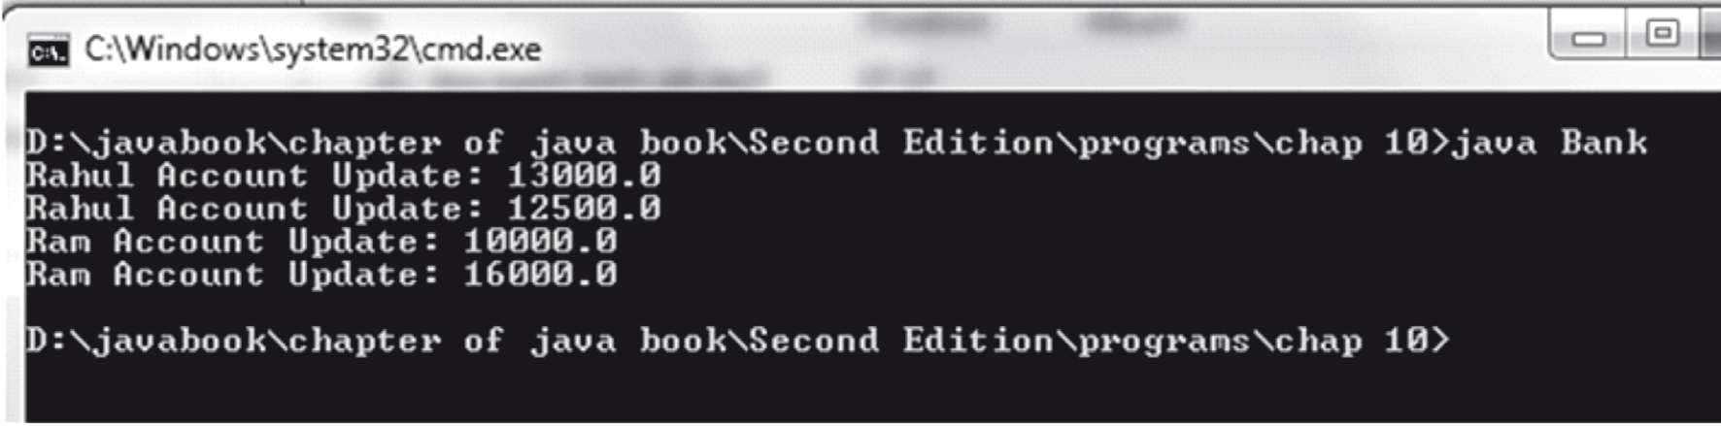
The Output

Slide 89
Runtime class
The Runtime class is used to know the information about free memory and total memory.
In addition to that it is also used for executing additional processes.
The current runtime instance is obtained using a static method of the Runtime class, i.e., getRuntime()

Slide 90
Runtime class Example
import java.io.*;
class RuntimeDemo{
public static void main(String args[]){
try{
Runtime r = Runtime.getRuntime();
System.out.println("Free Memory"+r.freeMemory());
System.out.println("Total Memory"+r.totalMemory());
Process pr1 = r.exec("cmd /c start");
Process pr2 = r.exec("notepad RuntimeDemo.java");

Slide 91
Runtime class Example
Process pr3 = r.exec("cmd /c dir");
InputStream is = pr3.getInputStream();
InputStreamReader isr = new InputStreamReader(is);
BufferedReader br = new BufferedReader(isr);
String line=null;
while ((line = br.readLine()) != null)
System.out.println(line);}
catch(Exception e){
System.out.println(e);}}}

Slide 92
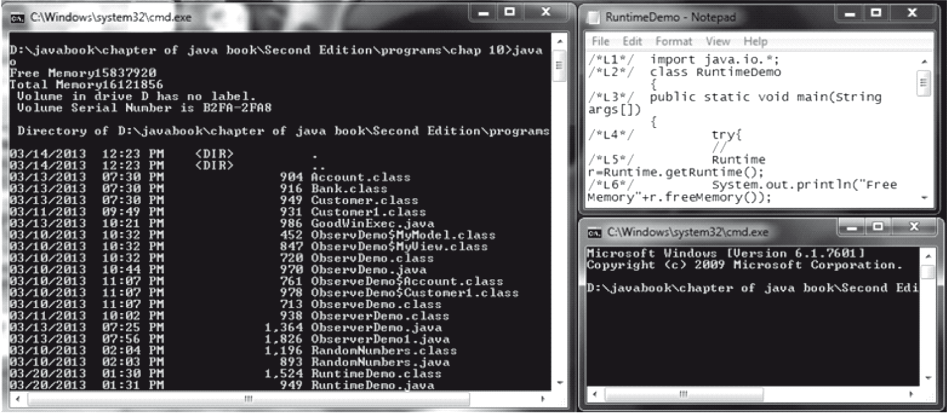
The Output

Slide 93
Reflection API
used to obtain information about the class with its various characteristics like
  attributes,
  constructors,
  methods,
  packages,
  modifiers (public, private, etc.),
  interfaces,
  arrays,
  exceptions, and
  generic types at runtime.

Slide 94
Reflection API
It can also be used to
  instantiate new objects,
  call methods,
  know about the setter/getter methods of a class and
  get or set fields.
available through java.lang.reflect package.

Slide 95
Reflection API
Before you can use reflection API on a class you need to obtain its java.lang.Class object.
A class object can be obtained in two ways:
  Class cl = MyClass.class;
  where MyClass is the name of the class
  Class cl = Class.forName(cn);
  where cn is the name of the class passed as a string

Slide 96
Reflection API Example
package ref;
import java.lang.reflect.*;
import java.io.*;
class Reflection implements Serializable{
private int demo;
public Reflection(int d, float b){
demo=d;}
public final void show() throws ArithmeticException{
System.out.println("Within show method of Reflection class");}

Slide 97
Reflection API Example
public static void main(String args[]) throws Exception{
Reflection r=new Reflection(10,20);
System.out.println("Class Name: "+ r.getClass().getName());
// constructors
Class c=Class.forName("ref.Reflection");
System.out.println("class modifier is : "+Modifier.toString(c.getModifiers()));
Constructor cs[] = c.getDeclaredConstructors();
System.out.println("Constructor:"+ cs[0].getName());

Slide 98
Reflection API Example
System.out.println("Constructor Modifier:"+ Modifier.toString(cs[0].getModifiers()));
System.out.println("Constructor Modifier is public: "+Modifier.isPublic(cs[0].getModifiers()));
// parameter types in the constructor
Class pt[] = cs[0].getParameterTypes();
System.out.print("Constructor Parameter Types: ");
for(int i = 0;i<pt.length;i++)
System.out.print(pt[i] + " ");
System.out.println();

Slide 99
Reflection API Example
// Methods
Method m[] = c.getDeclaredMethods();
for(int i = 0;i<m.length;i++){
System.out.println("Method: "+ m[i].getName());
System.out.println("Method Modifiers is : "+Modifier.toString(m[i].getModifiers()));
System.out.println("Method Modifiers is public: "+Modifier.isPublic(m[i].getModifiers()));
System.out.println("Method return type: "+m[i].getReturnType());}
m[0].invoke(r);

Slide 100
Reflection API Example
// Exception declared to be thrown by methods
Class et[] = m[0].getExceptionTypes();
for(int i = 0;i<et.length;i++)
System.out.println("Method Exception Types: "+et[i].getName());
// Super class info
Class s = c.getSuperclass();
System.out.println("Super Class Name: "+s.getName());

Slide 101
Reflection API Example
// Fields and their values
Field f[] = c.getDeclaredFields();
for(int i = 0; i<f.length;i++){
System.out.println("Field name: "+f[i].getName());
System.out.println("Field Type: "+f[i].getType());
System.out.println("Field value: "+f[i].get(r));
System.out.println("Field value Modifiers is "+Modifier.toString(f[i].getModifiers()));
f[i].set(r,56);
System.out.println("New Field value: "+f[i].get(r));}

Slide 102
Reflection API Example
// interfaces
Class in[]=c.getInterfaces();
System.out.println("Interfaces: "+in[0].getName());
//packages
Package cpackage=c.getPackage();
System.out.println("Package of the class: "+cpackage);
}}

Slide 103
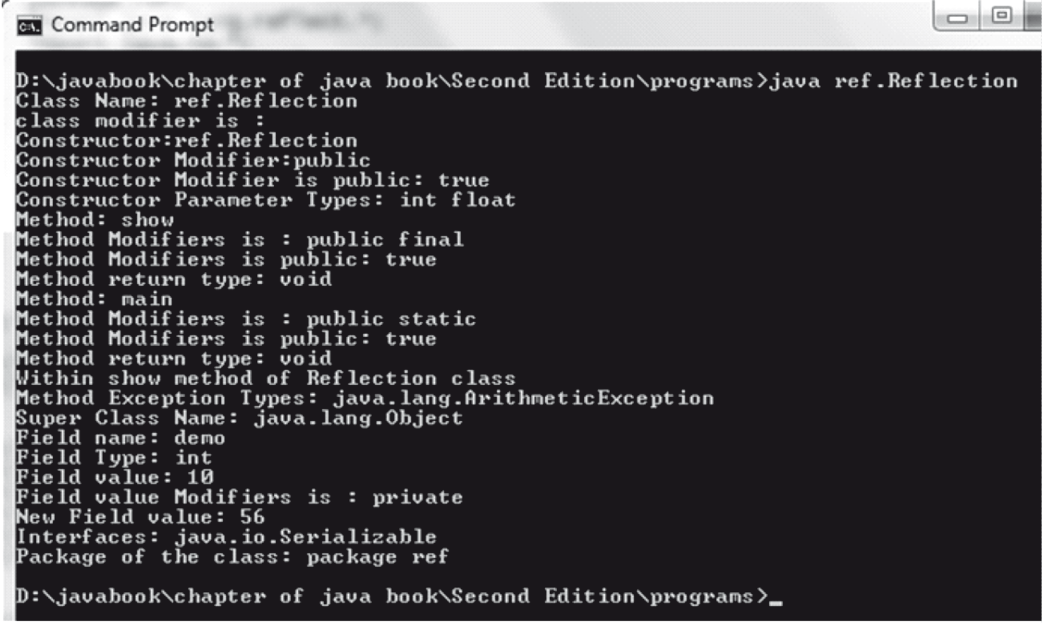
The Output

Slide 104
SUMMARY
This chapter focused on java.util package:
  Collection (a.k.a bag of objects) interfaces
  Generics
  data structure concepts like Linked list, stack, queues, trees, hashing e.t.c.
  classes like LinkedList, Stack, HashSet, TreeSet e.t.c
  a Map interface.
  Dynamic Array functionality: ArrayList and Vector.
  Legacy Interface Enumeration and newer Iterator interface :for iterating over the collection of objects.
  Random and Runtime class
  Observer and Observable
  Reflection API

